Slide 1
WELCOME TO MY PRESENTATION ON
CEP 758, Spring 2008
Mokter Hossain
Converting Data Into Information
Instructed By:
LaMont Johnson, PhD
Professor, Dept of CEP
University of Nevada, Reno

Slide 2
Converting Data Into Information
CEP 758, Spring 2008
Mokter Hossain
Introduction:
Data is the name or measure of an entity or an item
And Information is the simplified version of Data
That is Data is the raw material of Information
When Data is Organized or Processed it becomes Information

Slide 3
CEP 758, Spring 2008
Mokter Hossain
Converting Data Into Information
Objective:
In many purposes we collect data and process it to information
After completion of this tiny presentation you will have a clear understanding how raw data is converted to valuable information.

Slide 4
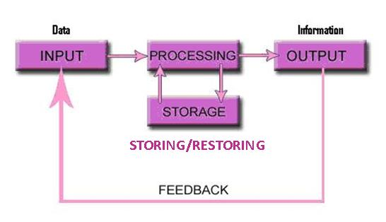
CEP 758, Spring 2008
Mokter Hossain
Converting Data Into Information
Information Processing Cycle (IPC):
The process through which Data is converted to Information is known as – Information Processing Cycle

Slide 5
CEP 758, Spring 2008
Mokter Hossain
Converting Data Into Information
Steps of IPC:
The process IPC includes four basic steps:
1) Input,
2) Processing,
3) Storing/Restring, and
4) Output.

Slide 6
CEP 758, Spring 2008
Mokter Hossain
Converting Data Into Information
IPC Step-1: Input:
Input means entering data into the computer or information system. This may be done manually or automatically. The input stage can be further broken down into acquisition, data entry and validation.

Slide 7
CEP 758, Spring 2008
Mokter Hossain
Converting Data Into Information
Typical Input Devices:
There is a wide range of input devices available and some are better suited than others for inputting data. These include: keyboard, mouse, barcode reader, scanner, joystick, microphone, touch screen, etc.

Slide 8
CEP 758, Spring 2008
Mokter Hossain
Converting Data Into Information
IPC Step-2: Processing:
Processing means performing operations on the data entered by input unit. This is the actual phase where the data is manipulated into information - a form that is useful to someone, and ready to use.

Slide 9
CEP 758, Spring 2008
Mokter Hossain
Converting Data Into Information
Typical Processing Devices:
Typical processing devices such as the microprocessors, coprocessors, and processing software such as word processors, spreadsheets, databases, payroll systems, web browsers are used to this.

Slide 10
CEP 758, Spring 2008
Mokter Hossain
Converting Data Into Information
IPC Step-3: Storing/Restoring:
Storing means saving something for future use. Both data and information can be stored so that it can be accessed in the future. And restring means retrieval of stored data for reusing/reprocessing.

Slide 11
CEP 758, Spring 2008
Mokter Hossain
Converting Data Into Information
Typical Storage Devices:
Most common storage devices are: Hard Disk, Floppy Disk, CD, DVD, Flash Disk, etc.

Slide 12
CEP 758, Spring 2008
Mokter Hossain
Converting Data Into Information
IPC Step-4: Output:
Output means of transmitting the processing result (information). All the previous steps are useless unless you can find the output. This could be in the form of printed paper, audio, video.

Slide 13
CEP 758, Spring 2008
Mokter Hossain
Converting Data Into Information
Typical Output Devices:
Typical output devices are: Monitor, Printer, Speakers, Plotters, etc.

Slide 14
CEP 758, Spring 2008
Mokter Hossain
Converting Data Into Information
Just Recall:

Slide 15
Thank You
CEP 758, Spring 2008
Mokter Hossain
Converting Data Into Information

